Slide 1
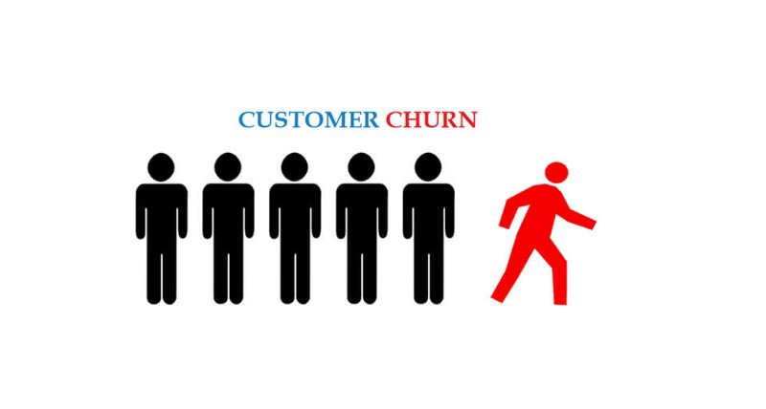
CUSTOMER CHURN ANALYSIS AND PREDICTION

Slide 2
What Is Customer Churn?
Customer churn is one of the most important metrics for a growing business to evaluate. While it's not the happiest measure, it's a number that can give a company the hard truth about its customer retention.
Customer churn is the percentage of customers that stopped using a company's product or service during a certain time frame. We can calculate churn rate by dividing the number of customers, a company lost during that time period (say a quarter) by the number of customers, a company had at the beginning of that time period.
For example, if we start our quarter with 400 customers and end with 380, our churn rate is 5% because we lost 5% of your customers.
Obviously, our company should aim for a churn rate that is as close to 0% as possible. In order to do this, our company has to be on top of its churn rate at all times and treat it as a top priority.

Slide 3
Why Is Customer Churn Rate Important?
Naturally, we may think like we're going to lose some customers here and there, and 5% doesn't sound too bad, right?
Well, it's important because it costs more to acquire new customers than it does to retain existing customers. In fact, an increase in customer retention of just 5% can create at least a 25% increase in profit.
This is because returning customers will likely spend 67% more on our company's products and services. As a result, our company can spend less on the operating costs of having to acquire new customers. We don't need to spend time and money on convincing an existing customer to select our company over competitors because they've already made that decision.
For instance, by simply decreasing our churn rate by 10% could add an extra $100,000 in revenue to our company. Dropping from 3% to 2.7% doesn't seem like a lot, but it actually adds large benefits to our company.

Slide 4
How to Reduce Customer Churn?
1. Focus attention on the best customers.
Rather than simply focusing on offering incentives to customers who are considering churning, it could be even more beneficial to pool our resources into our loyal, profitable customers.
2. Analyze churn as it occurs.
Use our churned customers as a means of understanding why customers are leaving. Analyze how and when churn occurs in a customer's lifetime with our company, and use that data to put into place preemptive measures.
3. Show customers that we care.
Instead of waiting to connect with our customers until they reach out to us, we can try a more proactive approach. We can communicate with them all the perks we offer and show them that we care about their loyalty by awarding bonus points and more discounts, and they'll be sure to stick around.

Slide 5
TELECOMMUNICATION CASE STUDY
Now a days, the telecommunications industry is facing dramatic and complex challenges due to the rapid development of information& technology and influence of global competition. As the telecommunications market grows increasingly competitive, customer expectation is increasing as well. Today’s customers can exercise their purchase power by choosing from many product providers to satisfy their communication needs. Accordingly, the major task facing the telecommunications industry is how to provide better services and better quality at low cost. There is high competitive market due to the number of vibrant competitive service providers. Customer Churn is the major issue that is being faced by Telecommunication industries in the world. Churn is the activity of customer leaving the company and discarding the services offered by it, due to the dissatisfaction with the services provided by the company.

Slide 6
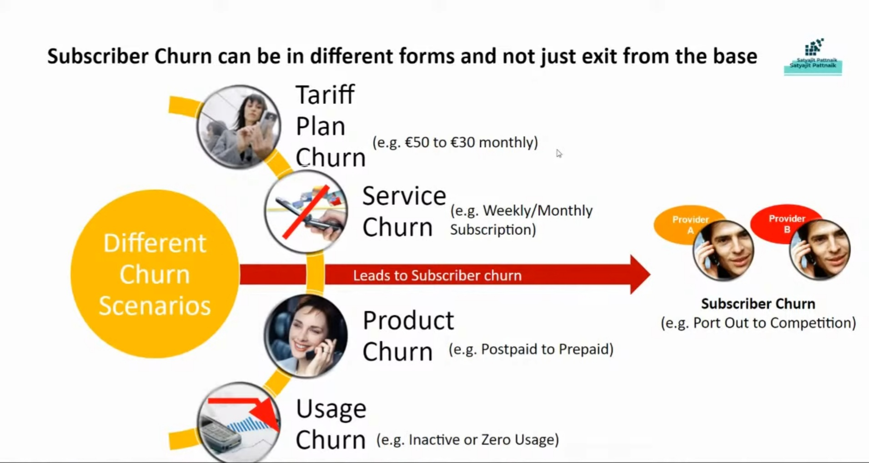

Slide 7
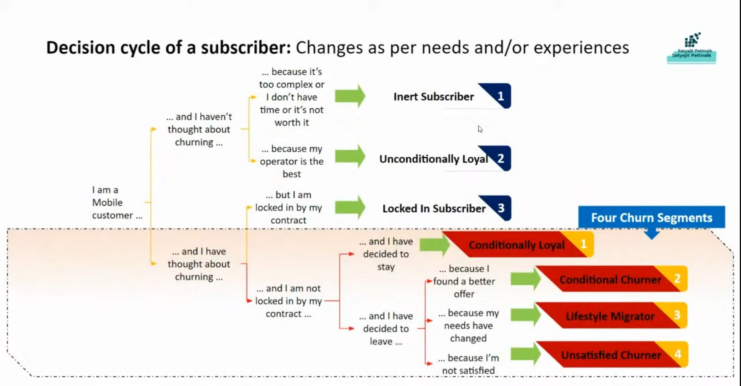

Slide 8
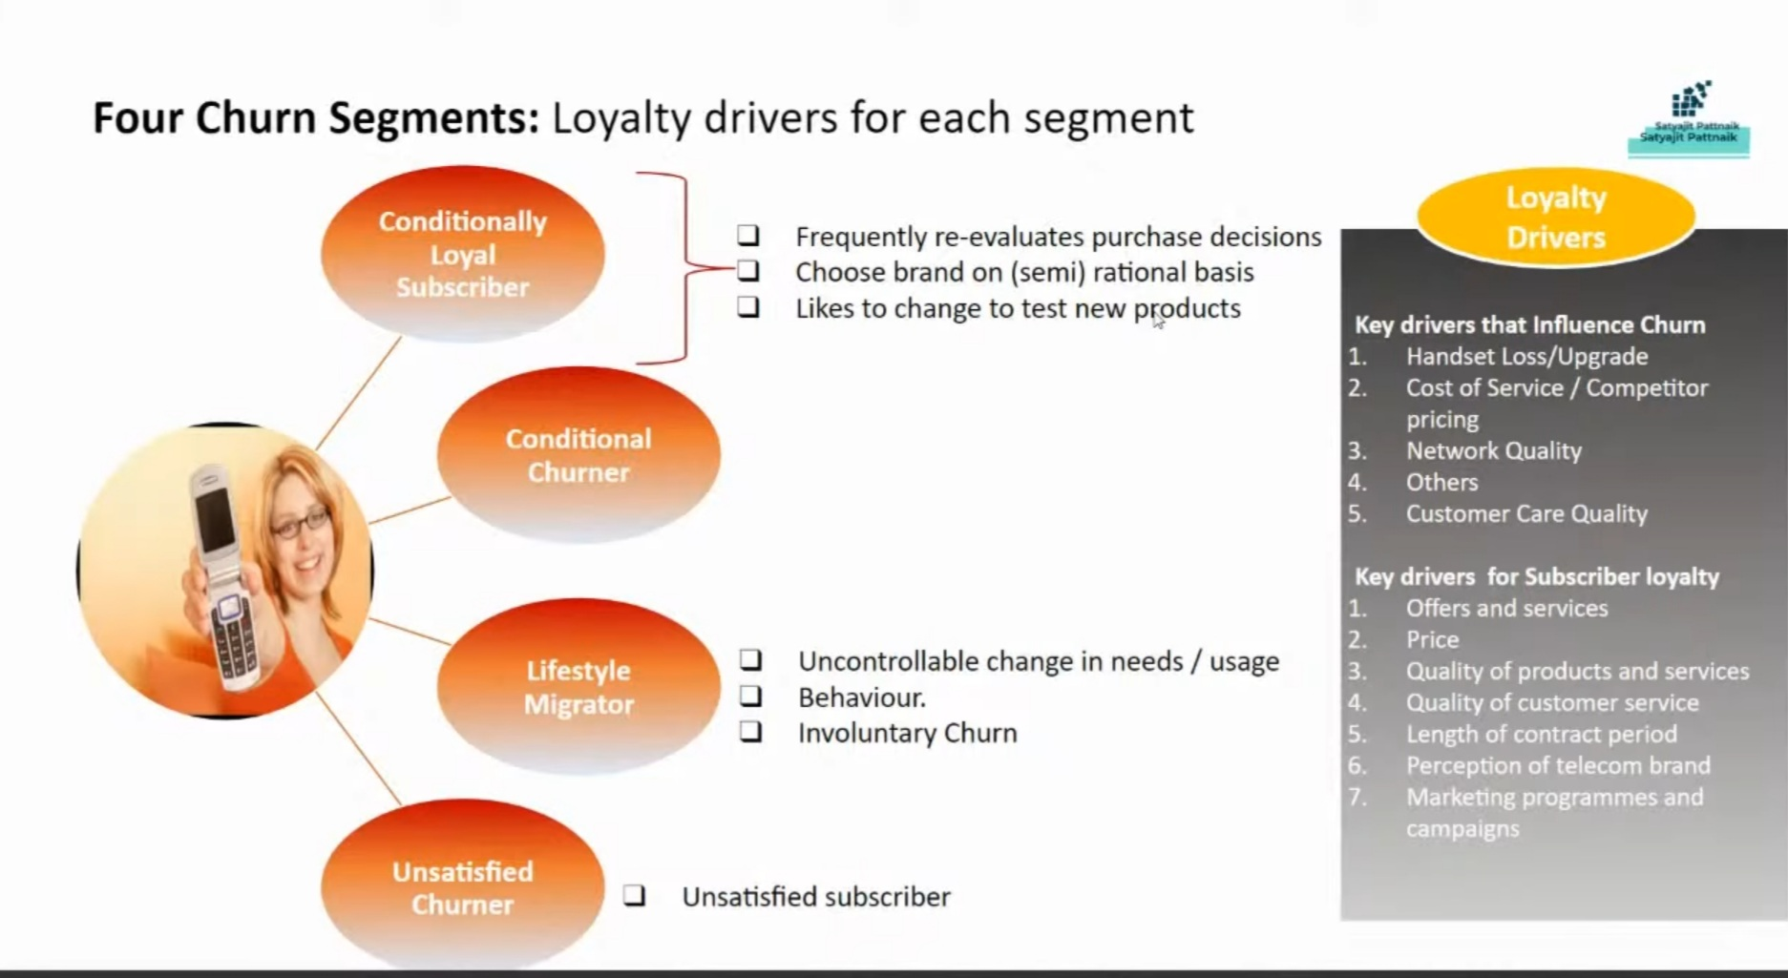

Slide 9
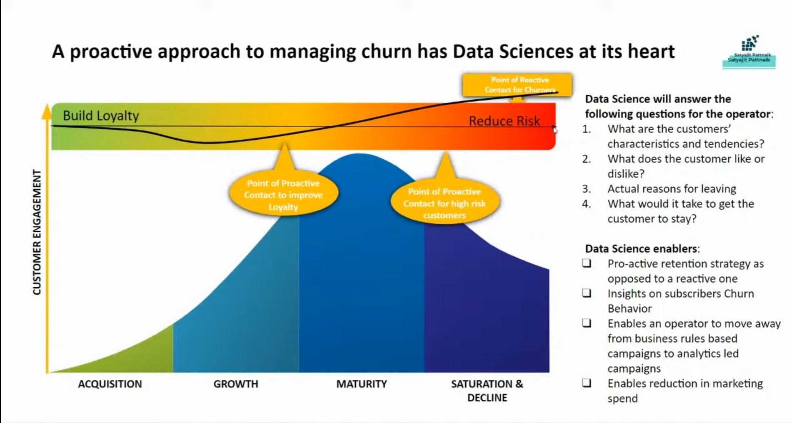

Slide 10


